Slide 1
Presentation of Boys style.

Slide 2
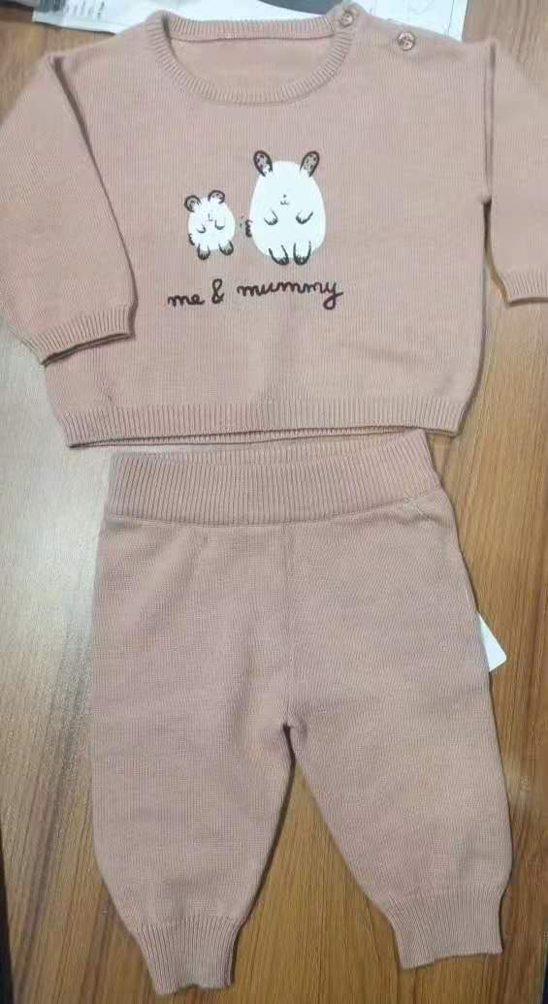
AFFLUENCE FASHION LIMITED
DEPT: Boys SIZE: 68
COMP : 100% coton GAUGE: 12 WT: 5.40 LBS.

Slide 3
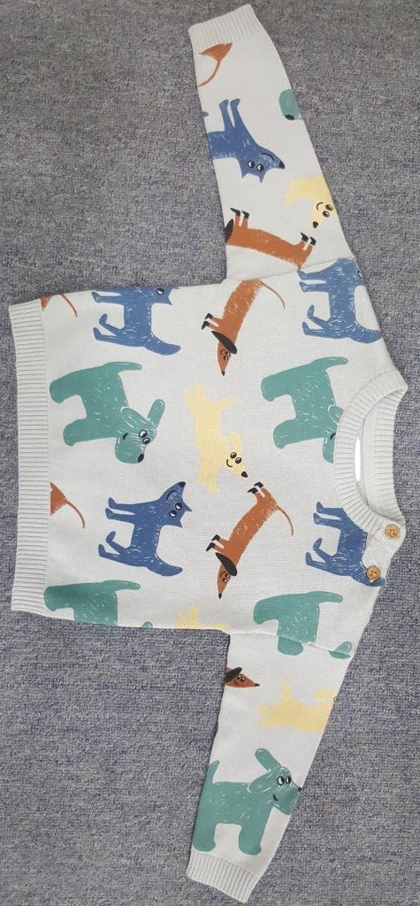
AFFLUENCE FASHION LIMITED
DEPT: Boys SIZE: 80
COMP : 100% cotton GAUGE: 12 WT: 2.70 LBS.

Slide 4
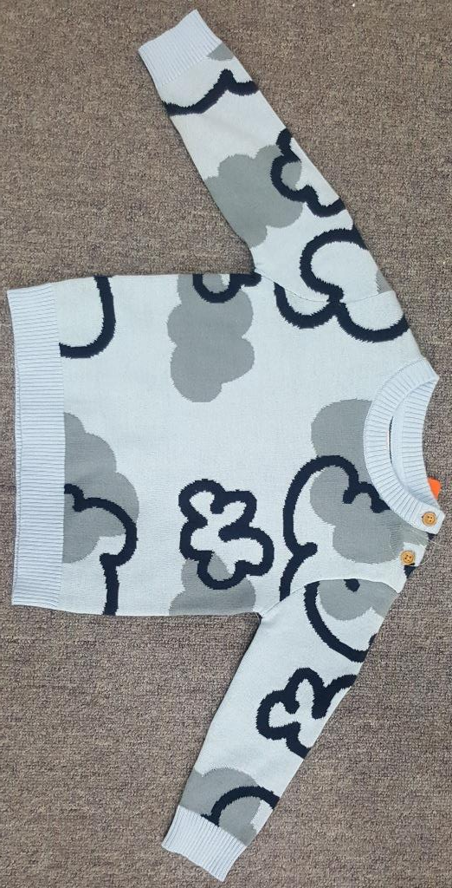
AFFLUENCE FASHION LIMITED
DEPT: Boys SIZE: 80
COMP : 100% Cotton GAUGE: 12 WT: 3.30 LBS.

Slide 5
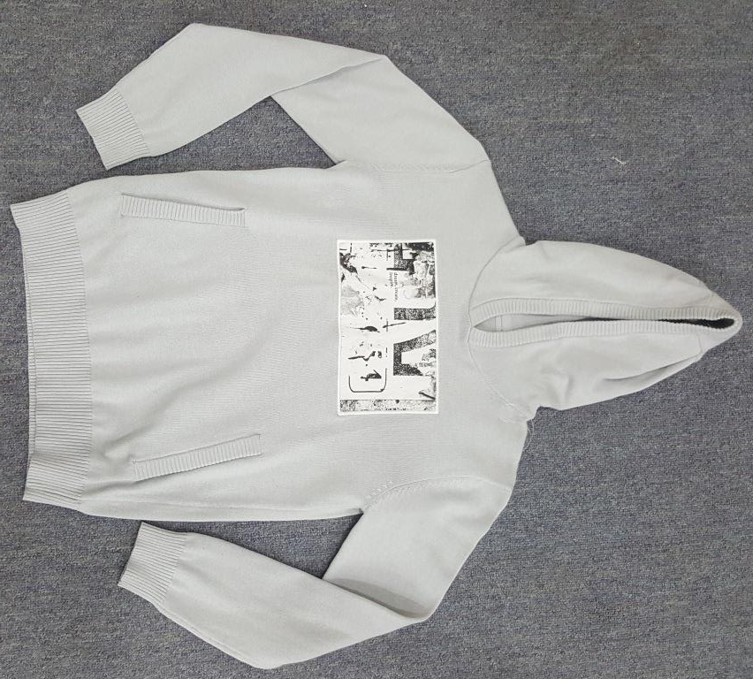
AFFLUENCE FASHION LIMITED
DEPT: Boys SIZE: 140
COMP : 100% Cotton GAUGE: 12 WT: 7.50 LBS.

Slide 6
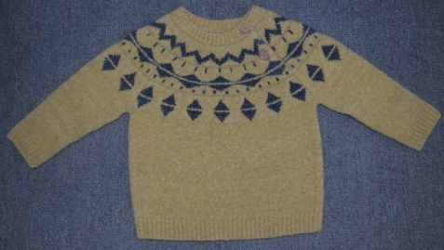
AFFLUENCE FASHION LIMITED
DEPT: Boys SIZE: 80 GAUGE: 7
COMP : 58ACRYLIC 25NYLON 15WOOL 2SPANDEX WT: 4.50 LBS.

Slide 7
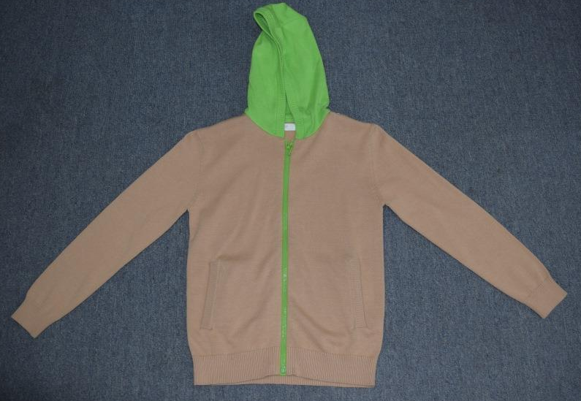
AFFLUENCE FASHION LIMITED
DEPT: Boys SIZE: 140 GAUGE: 12
COMP : 100% Cotton WT: 8.40 LBS.

Slide 8
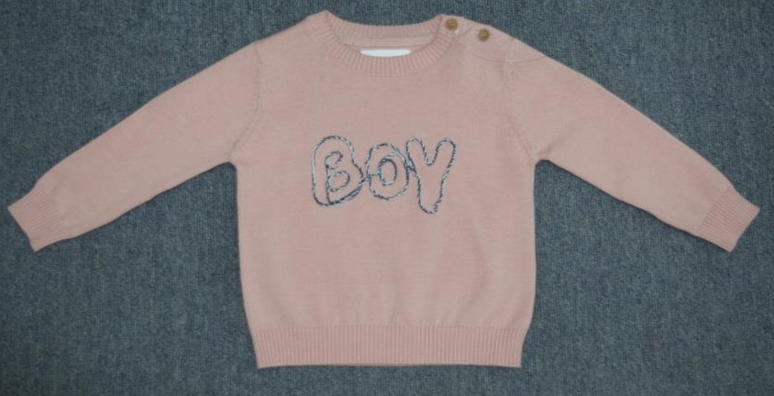
AFFLUENCE FASHION LIMITED
DEPT: Boys SIZE: 80 GAUGE: 12
COMP : 100% Cotton WT: 2.40 LBS.

Slide 9
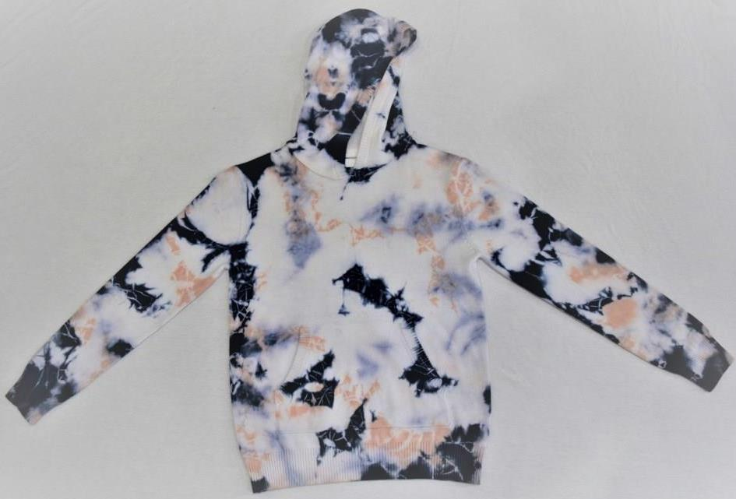
AFFLUENCE FASHION LIMITED
DEPT : Boys SIZE : 140 GAUGE: 12
COMP : 100% cotton Tie dye WT: 7.70 LBS.

Slide 10
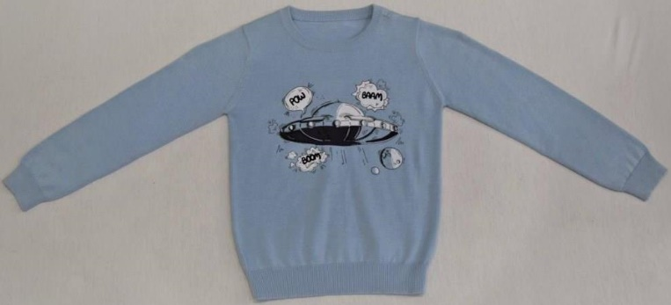
AFFLUENCE FASHION LIMITED
DEPT : Boys SIZE : 116 GAUGE: 12
COMP : 100% cotton WT: 3.50 LBS.

Slide 11
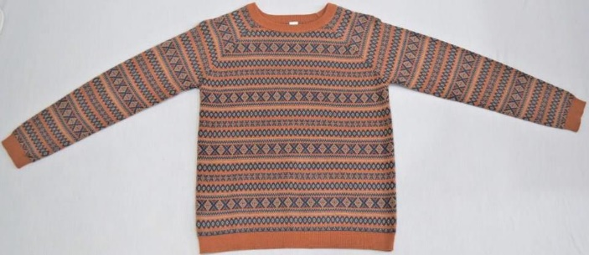
AFFLUENCE FASHION LIMITED
DEPT : Boys SIZE : 140 GAUGE: 12
COMP : 47% cotton 27% Acrylic 18% polyamide 8% wool, WT: 7.60 LBS.

Slide 12
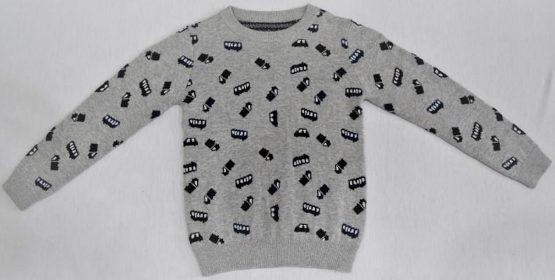
AFFLUENCE FASHION LIMITED
DEPT : Boys SIZE : 116 GAUGE: 12
COMP : 100% cotton WT: 3.50 LBS.

Slide 13
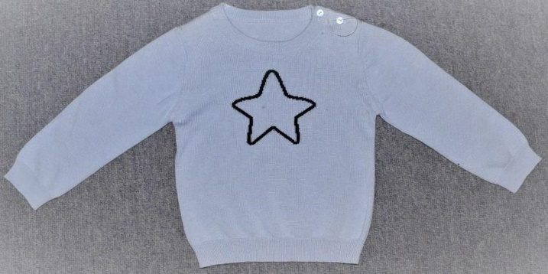
AFFLUENCE FASHION LIMITED
DEPT : Boys SIZE : 80 GAUGE: 12
COMP : 100% cotton WT: 2.40 LBS.

Slide 14
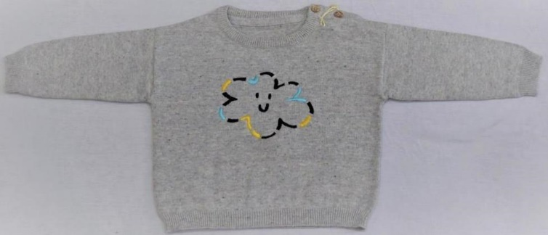
AFFLUENCE FASHION LIMITED
DEPT : Boys SIZE : 68 GAUGE: 12
COMP : 100% cotton WT: 2.10 LBS.

Slide 15
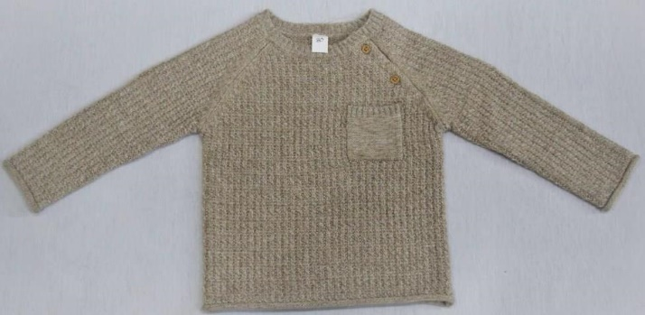
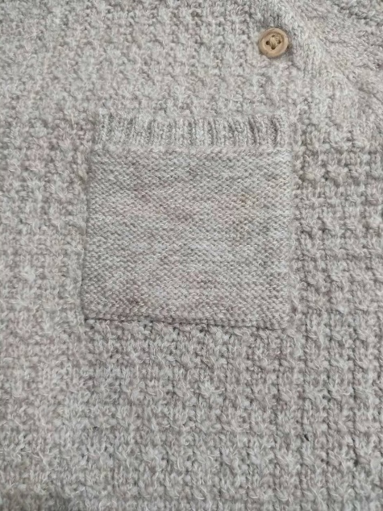
AFFLUENCE FASHION LIMITED
DEPT : Boys SIZE : 80 GAUGE: 7
COMP : 50% Acrylic 26% polyester 24% cotton +1ply nylon WT: 3.40 LBS.

Slide 16
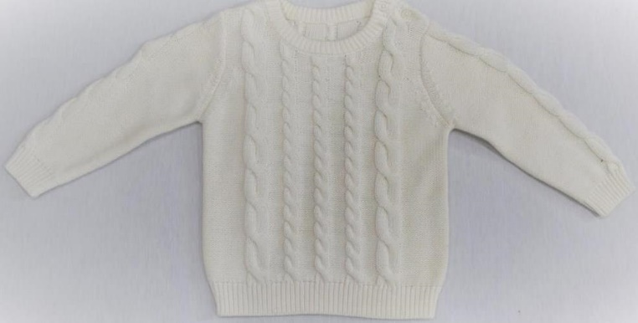
AFFLUENCE FASHION LIMITED
DEPT : Boys SIZE : 80 GAUGE: 5
COMP : 100% cotton WT: 4.70 LBS.

Slide 17
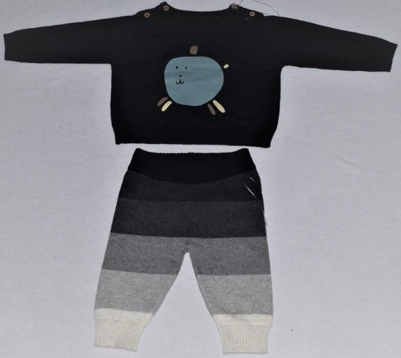
AFFLUENCE FASHION LIMITED
DEPT : Boys SIZE : 68 GAUGE: 12
COMP : 100% cotton WT: 4.80 LBS.

Slide 18
PRESENTED BY
AFFLUENCE FASHION LTD.

