Slide 1

AFFLUENCE FASHION LIMITED. IS ONE OF THELEADING FASHION BUYING HOUSE IN BANGLADESH.

Slide 2

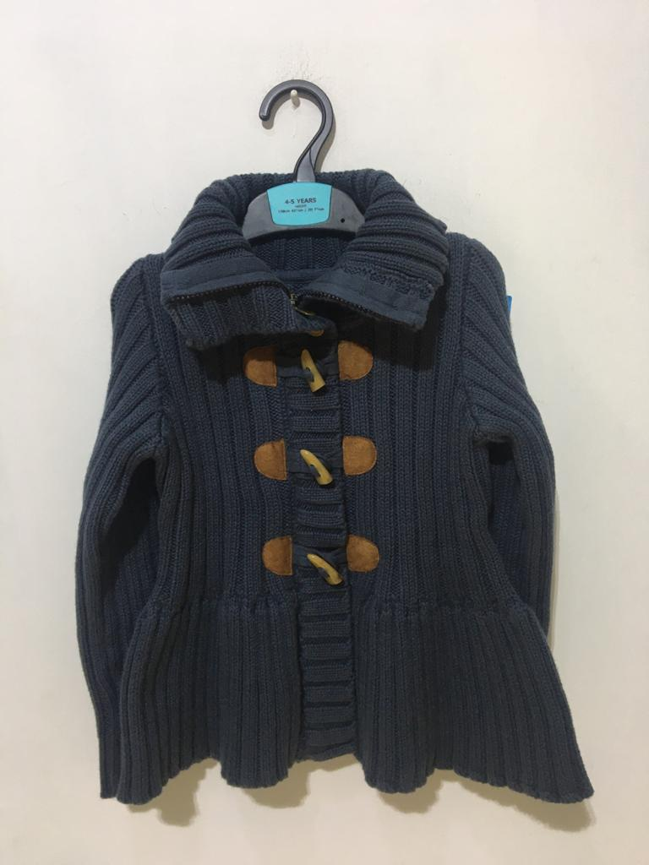
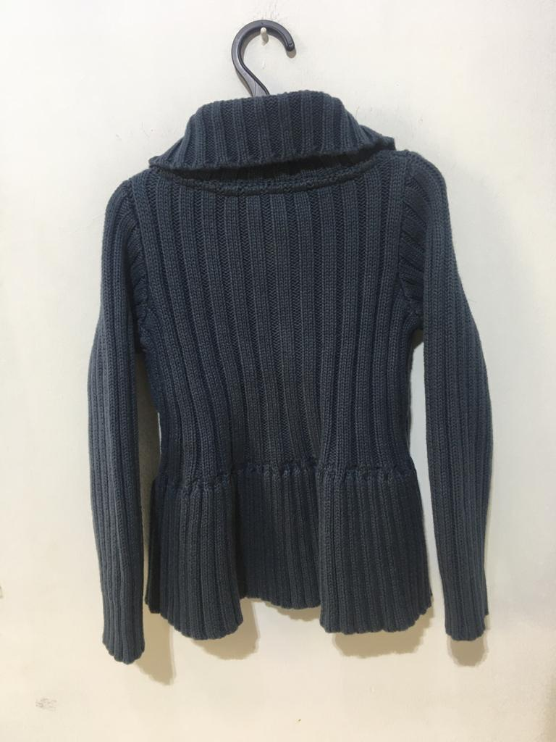
STYLE : ASL-109
Composition: 100% Cotton
Gauge: 5/7 gg

Slide 3

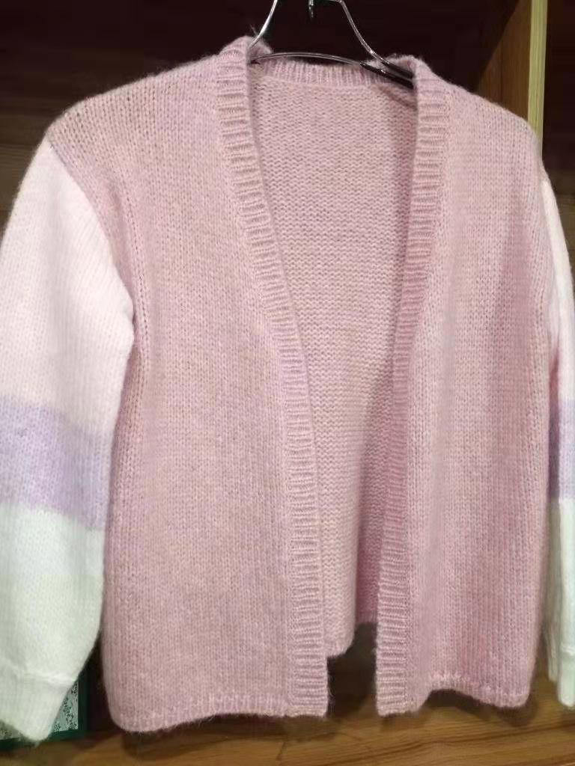
STYLE : ASL- 6780
Composition: 70ACRYLIC 22RECYCLE POLYESTER 8NYLON
GG- 3

Slide 4

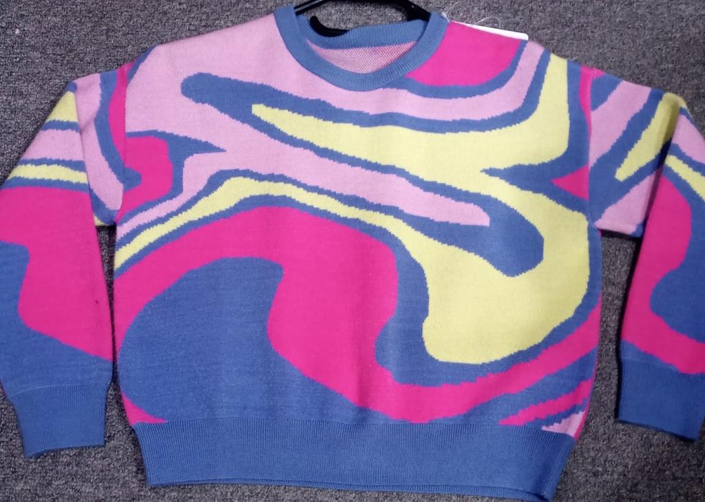
STYLE : ASL- 2719
Composition: 50 viscose 28 polyester 22 nylon
Gauge: 12 gg

Slide 5

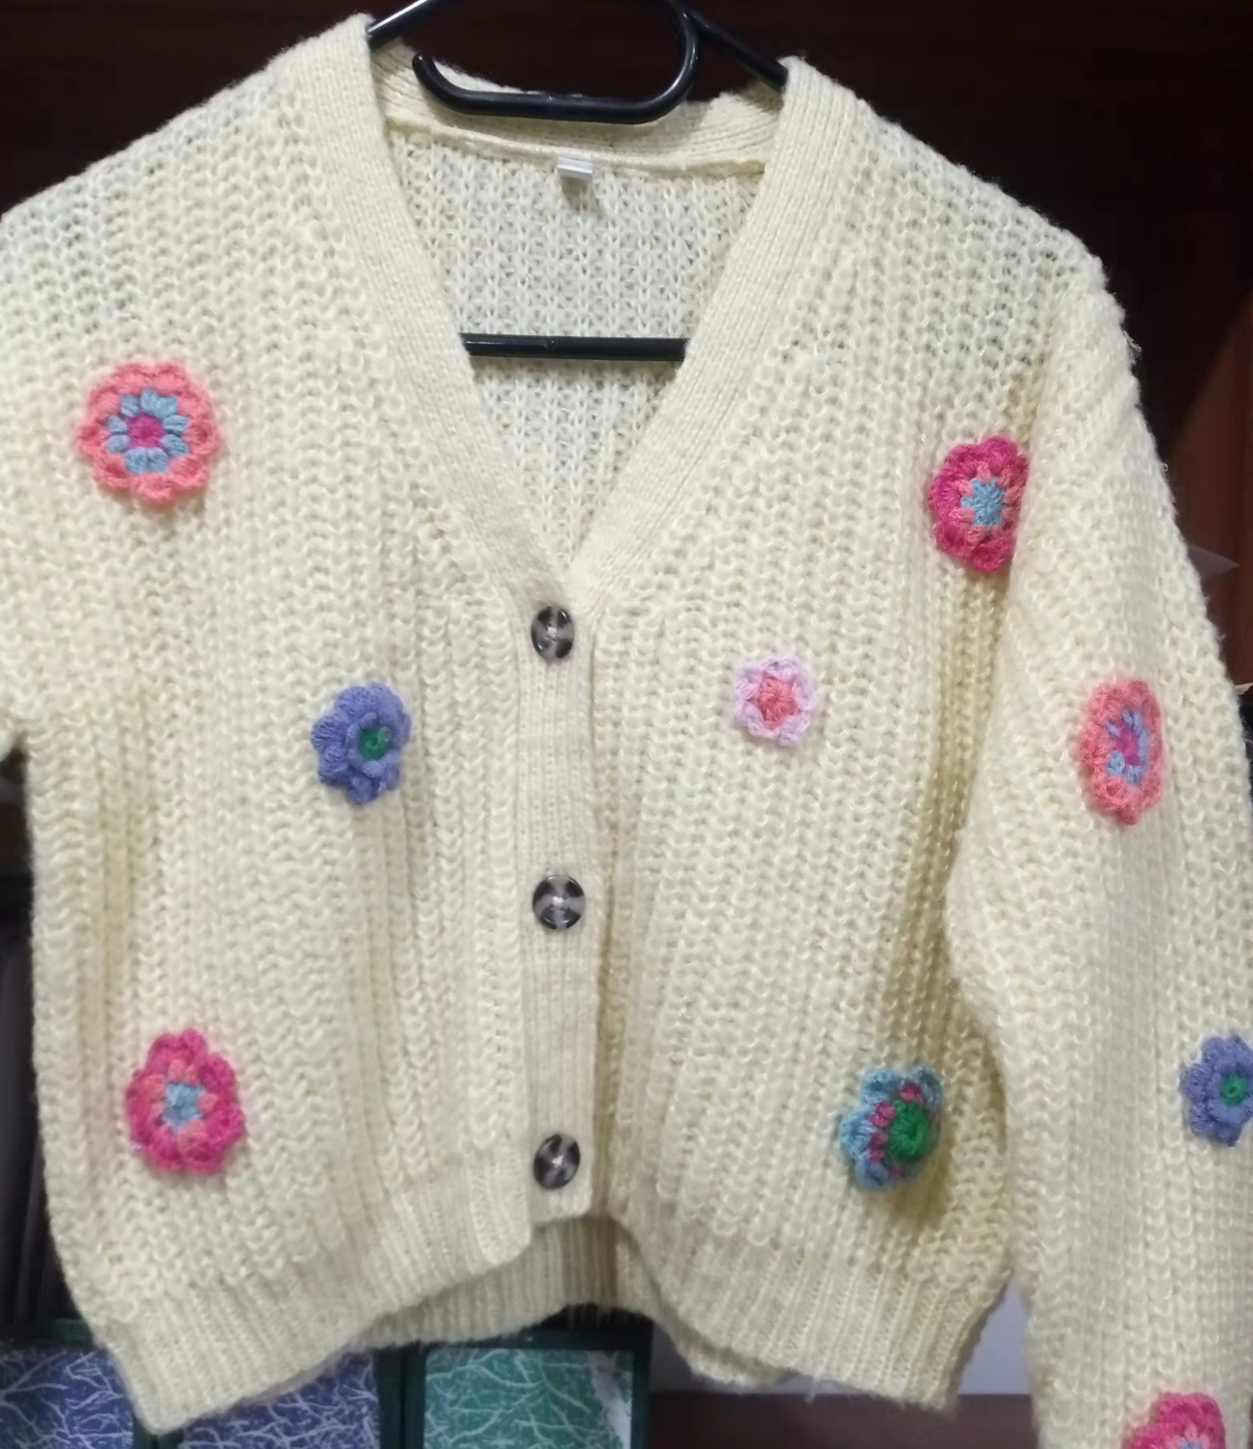
STYLE : ASL- 6791
Composition: 100% acrylic M/ like
Gauge: 5 gg

Slide 6

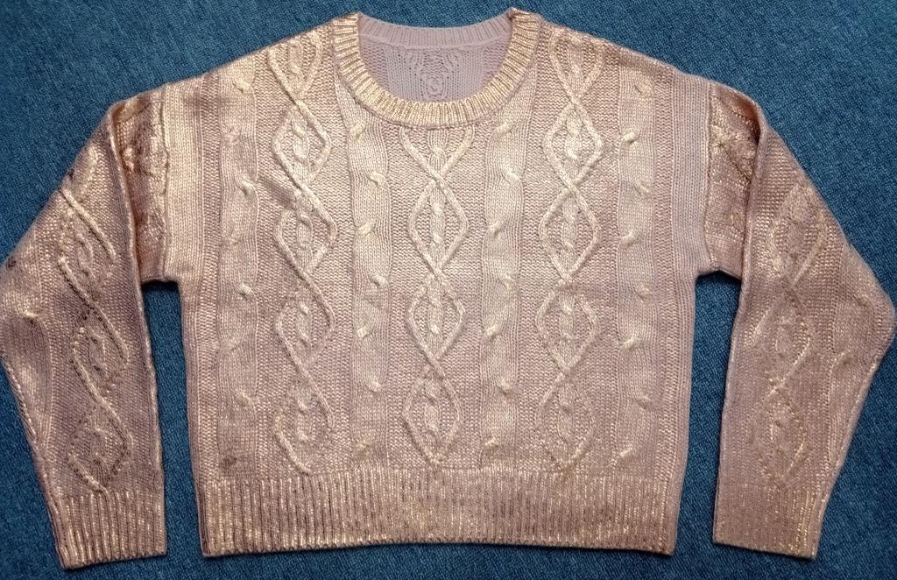
STYLE : 091629
Composition: 100% Acrylic, Foil print
Gauge: 5 gg

Slide 7

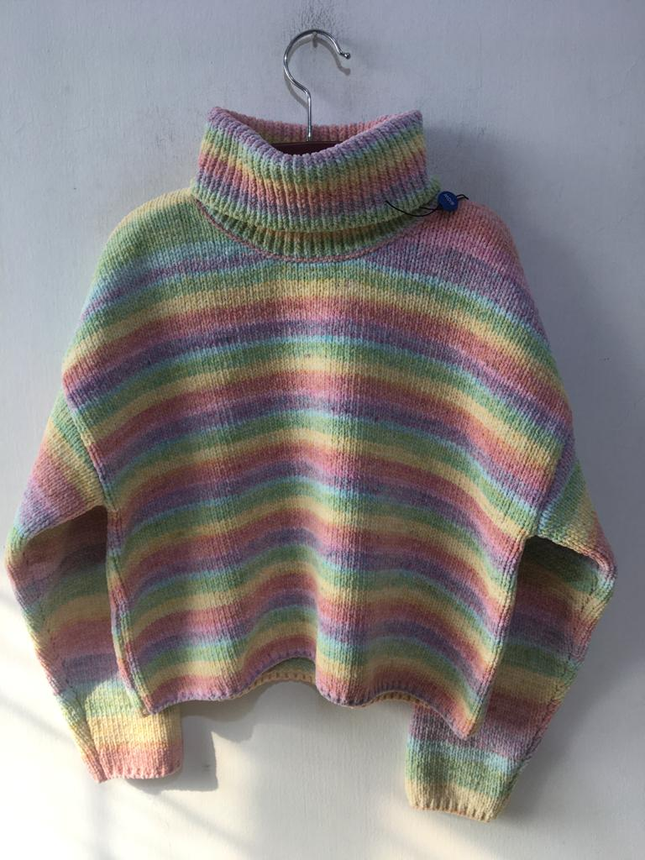
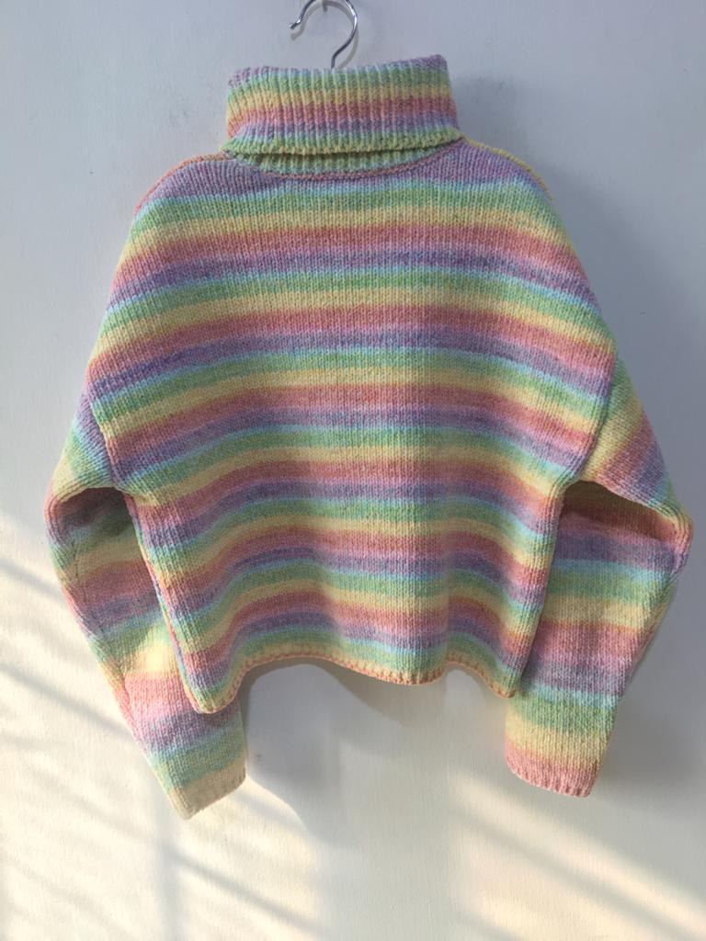
STYLE : ASL-114
Composition: 100% Polyester (space dye)
Gauge: 3/5 gg

Slide 8

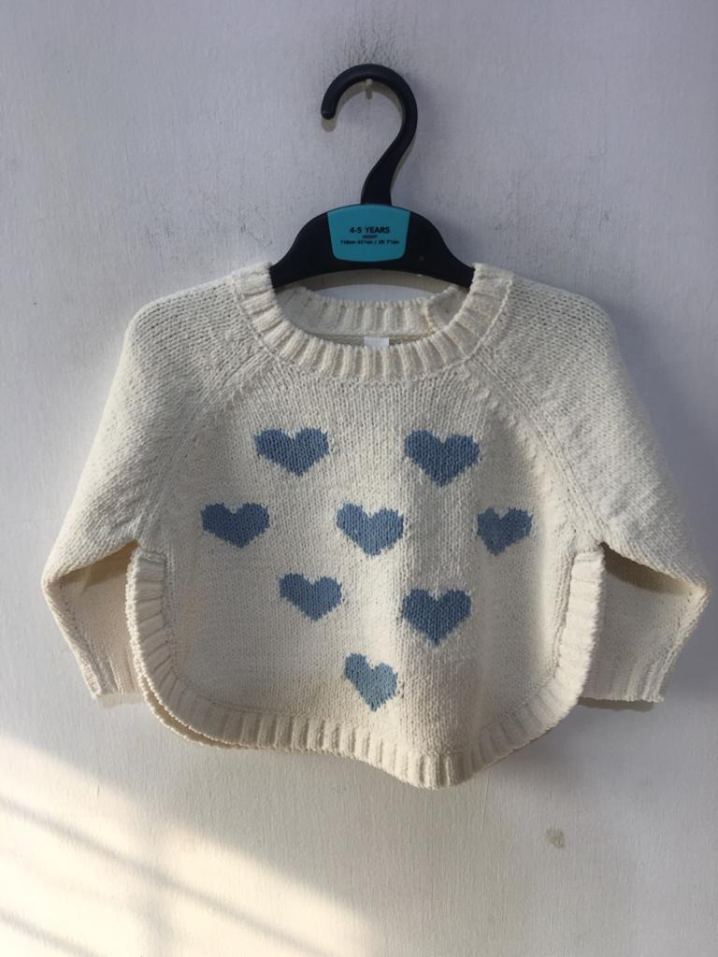
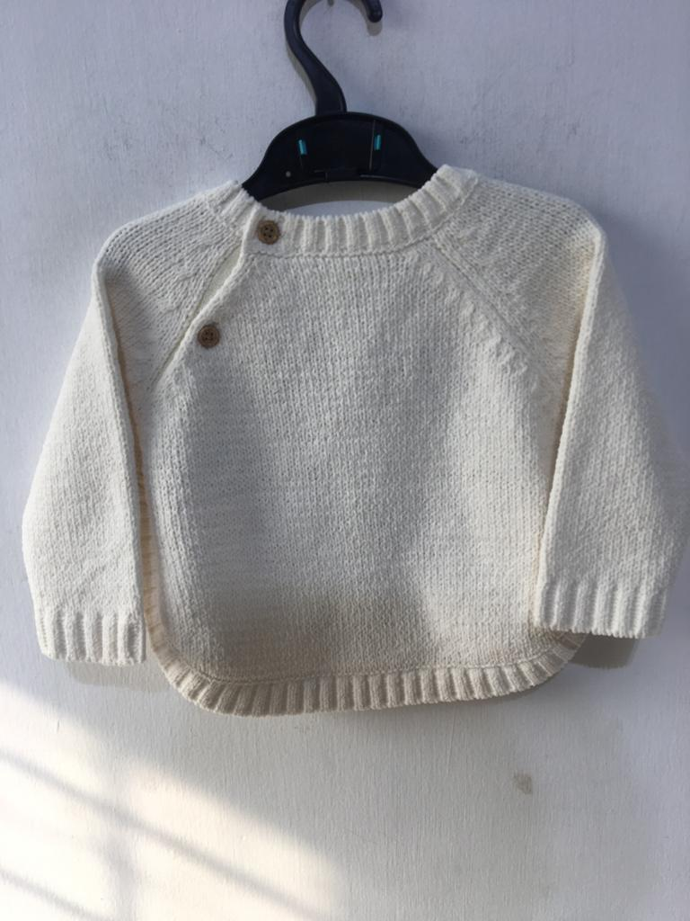
STYLE : ASL-116
Composition: 100% Polyester chenille
Gauge: 5 gg

Slide 9
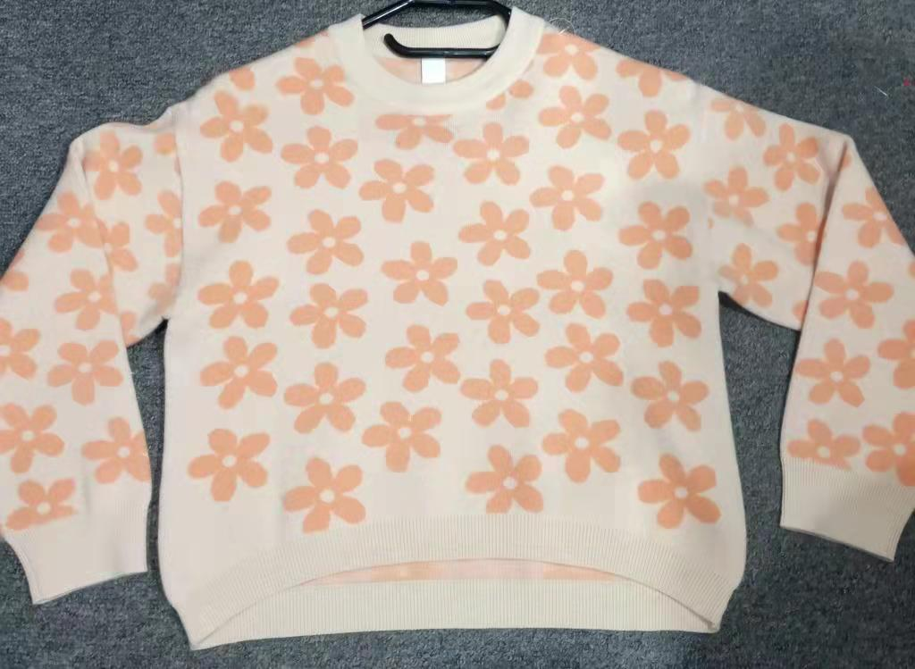
STYLE : ASL-2011
Composition: 50 viscose 28 polyester 22 nylon
Gauge: 12 gg

Slide 10
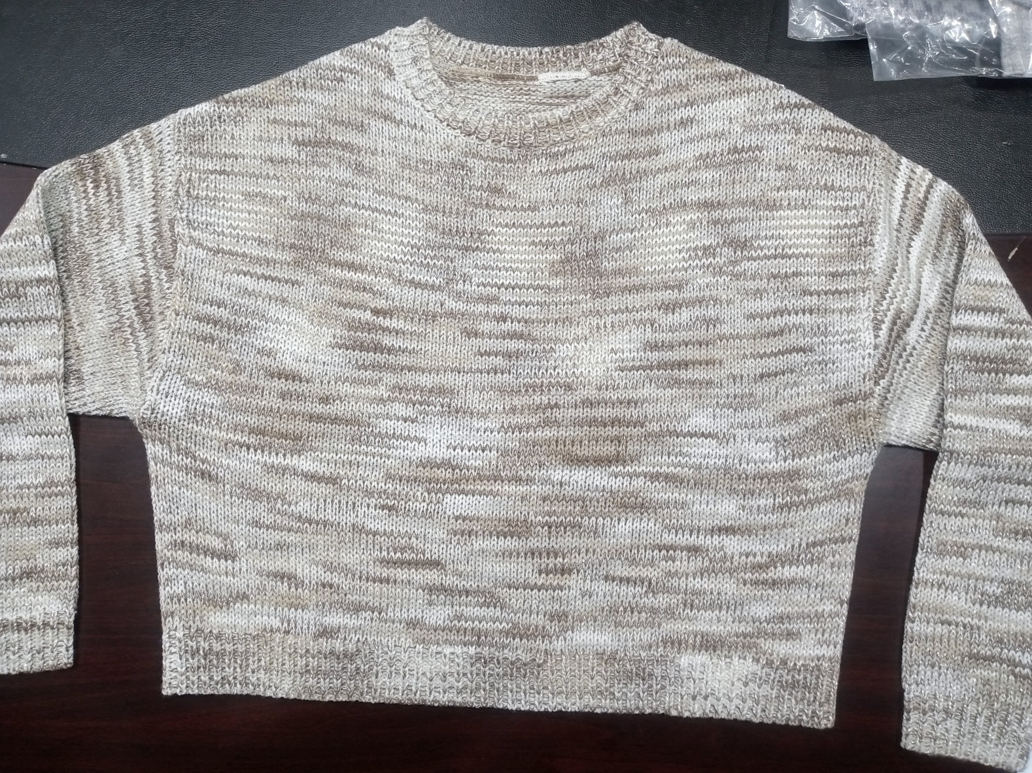
STYLE : ASL-611
Composition: 100% ACRYLIC ( Space dye)
Gauge: 3 gg

Slide 11
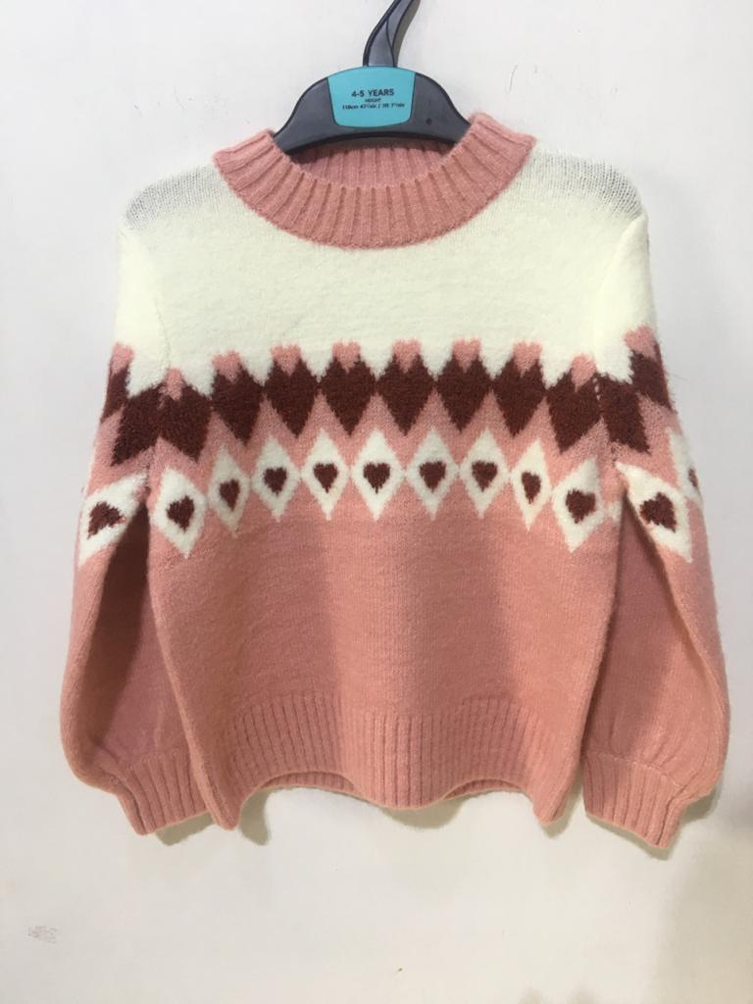
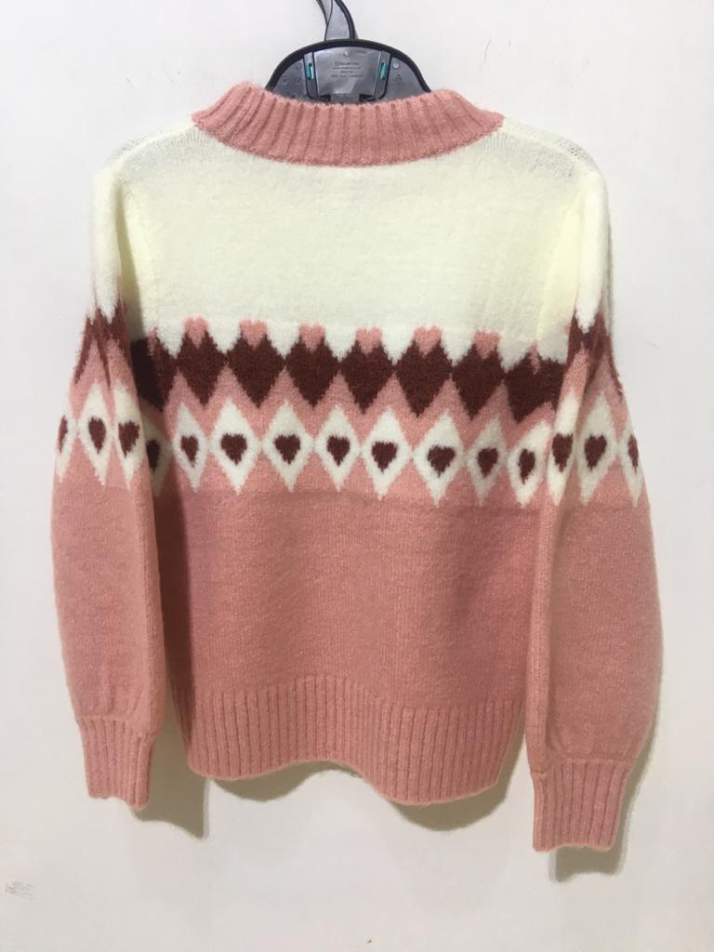
STYLE : ASL-117
Composition: Acrylic/ nylon/ spandex
Gauge: 5 gg

Slide 12
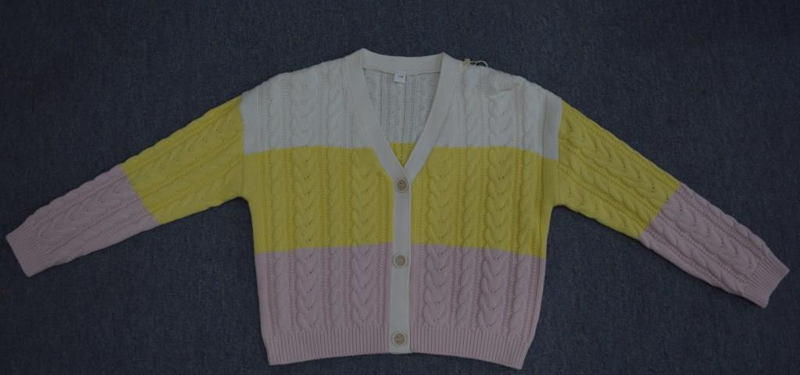
STYLE : ASL-8415
Composition: 100 % cotton
Gauge: 5 gg

Slide 13
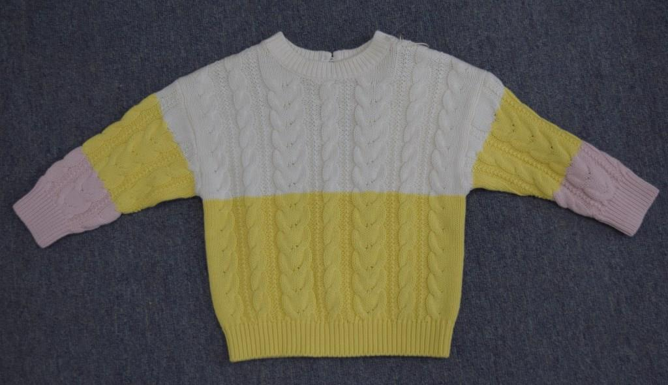
STYLE : ASL-0204
Composition: 100 % cotton
Gauge: 5 gg

Slide 14
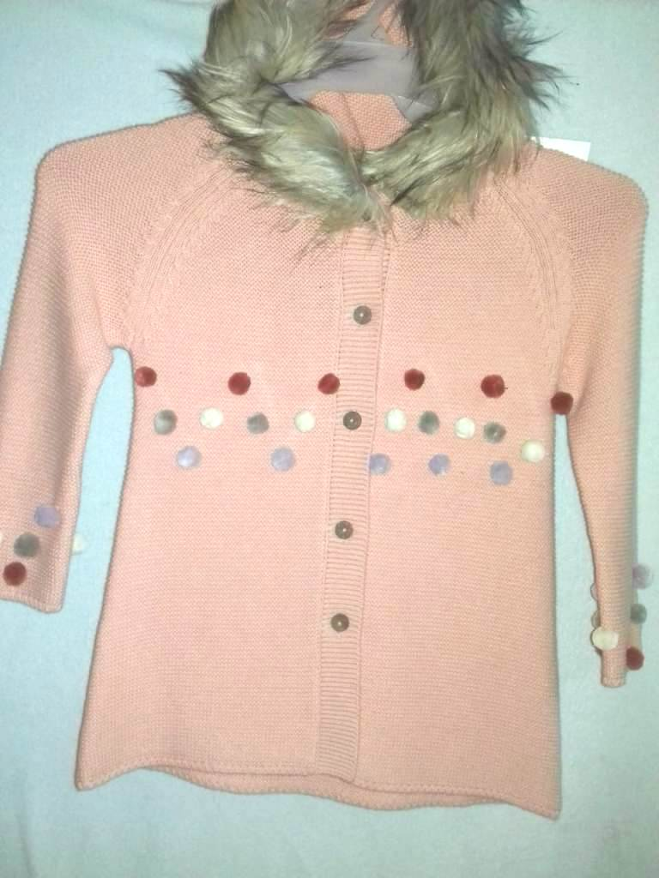
STYLE : ASL-1221L
Composition: 100 % cotton
Gauge: 5 gg

Slide 15
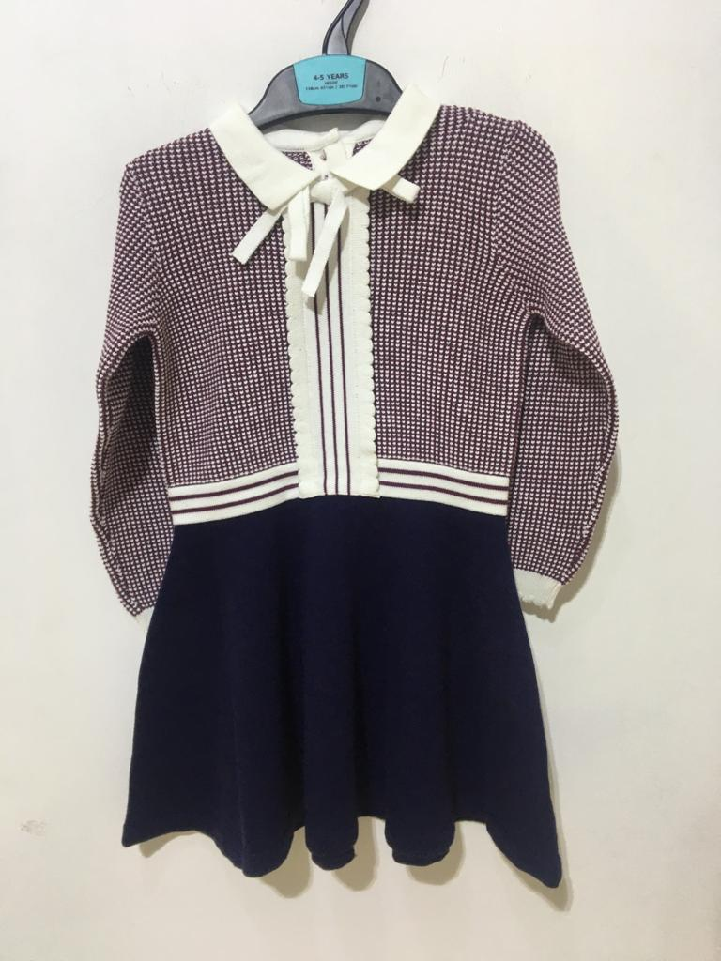
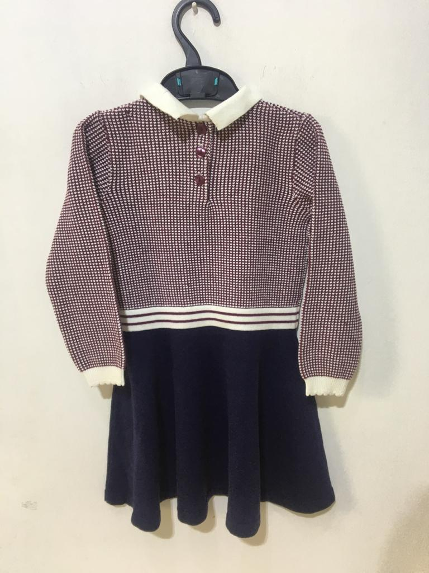
STYLE : ASL-124 Composition: 100% Cotton
Gauge: 12 gg

Slide 16
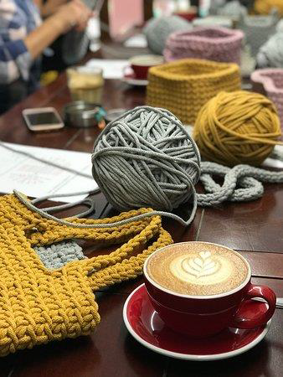
Thank you.

